Slide 1
BIG DATA ANALYSIS
Minh Duy Truong
May 11th, 2024

Slide 2
COMPONENTS
Introduction
Data explanation
Overview
Analysis
Recommendations

Slide 3
INTRODUCTION
A live-streaming platform conducted an analysis on customer behavior data from April 1st 2022 – April 30th 2022.
Purposes:
Gain more insights on customers’ behavior
Improve on customer services for different customer segmentations.

Slide 4
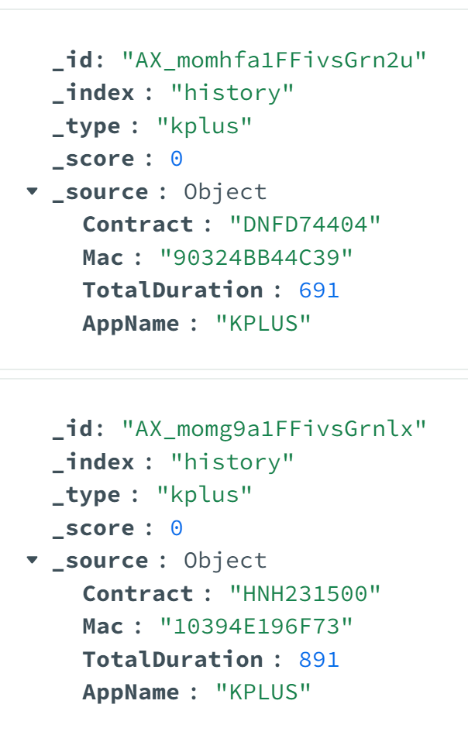
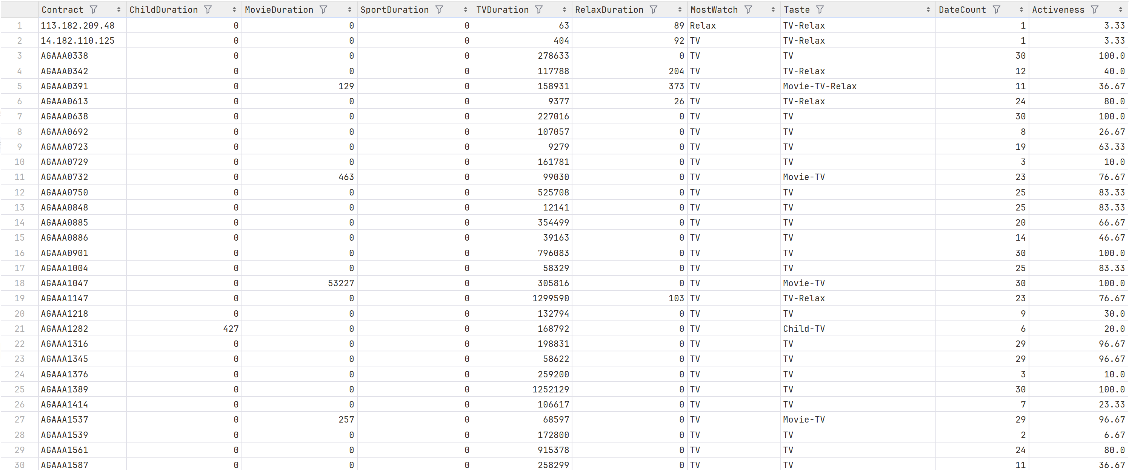
DATA
OLTP was stored in Data Lake as JSON file. After ETL process, it became OLAP data and stored in Data Warehouse as CSV file.
ETL
OLTP data
OLAP data

Slide 5
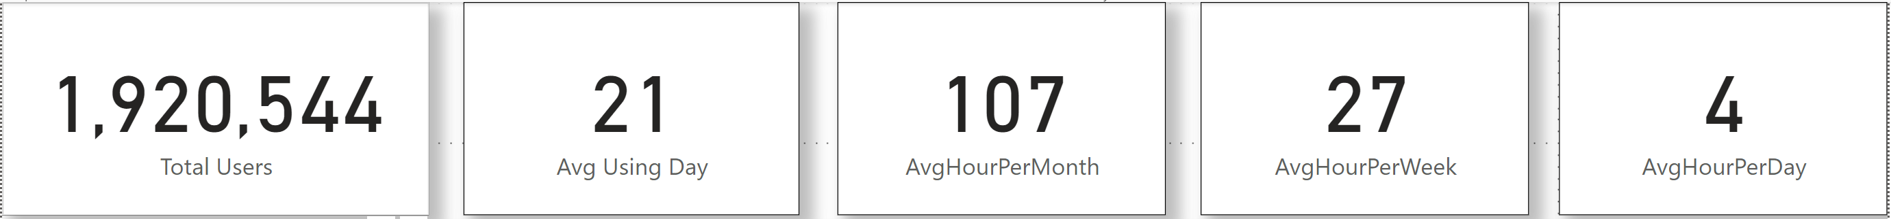
OVERVIEW
In April 2022, platform had over 1.9M Users.
By average, each user used the service for 21 days.
An average user spent:
107 hours on service per month,
27 hours per week
4 hours per day

Slide 6
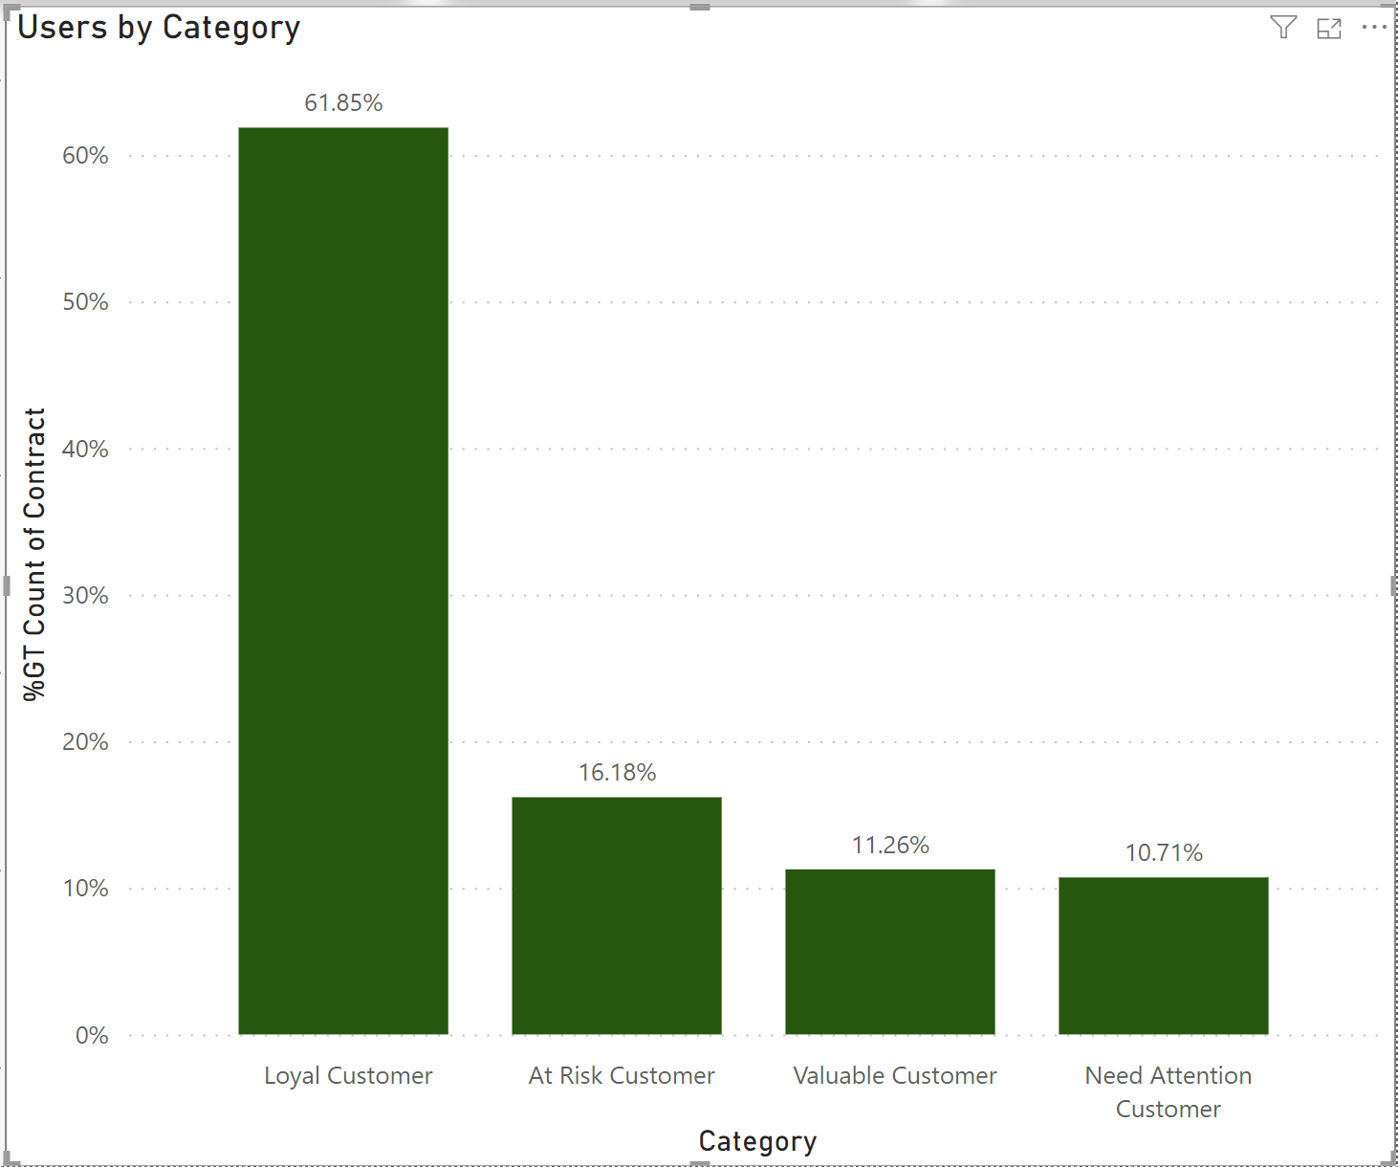
ANALYSIS
We can split customers into 4 categories:
At risk: <7 days using service
Need attention: 7-14 days using service
Valuable: 14-21 days using service
Loyal: > 21 days using service
We can see 61.85% customers and revenue come from Loyal customers
=> Convert customers into Loyal Customers.

Slide 7
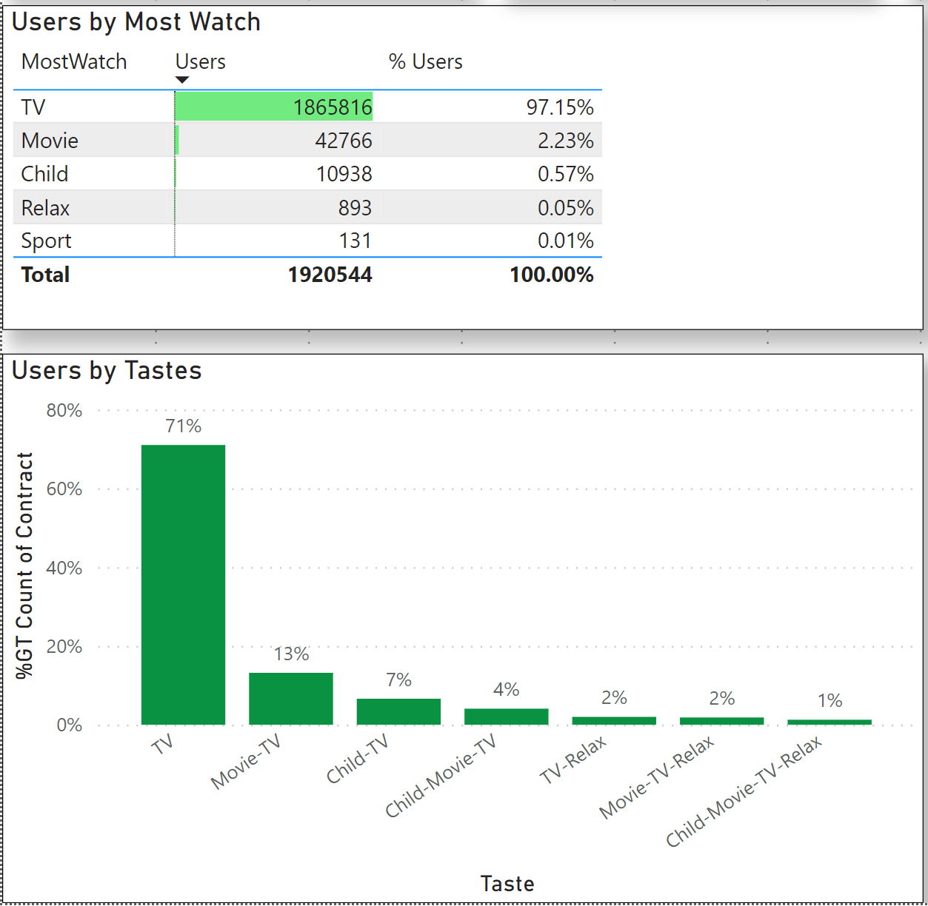
ANALYSIS
Analyzing Users by Most Watch:
97% Users watch TV the most
71% Users ONLY watch TV
13% watch TV and Movie
7% watch TV and Child
4% watch TV, Child, and Movie
=> We’ll exclude customers who watched TV only for further analysis

Slide 8
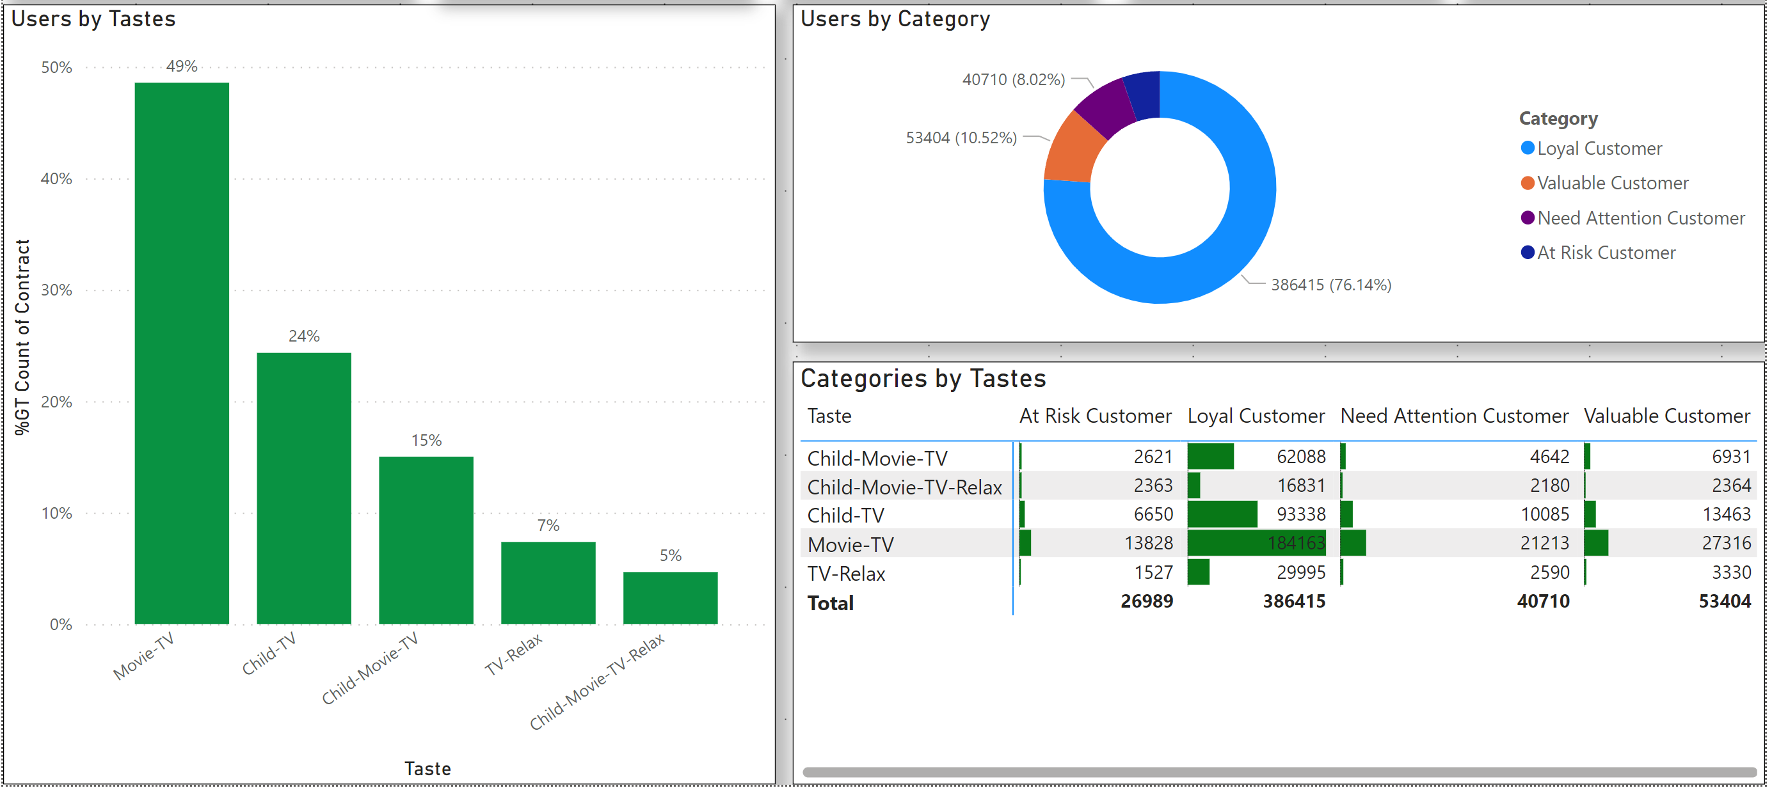
ANALYSIS
Majority is Loyal customers 76.14%
Movie-TV is the second highest taste, follow up is Child-TV, and Child-Movie-TV
Top 3 Contents: TV, Movie, and Child.

Slide 9
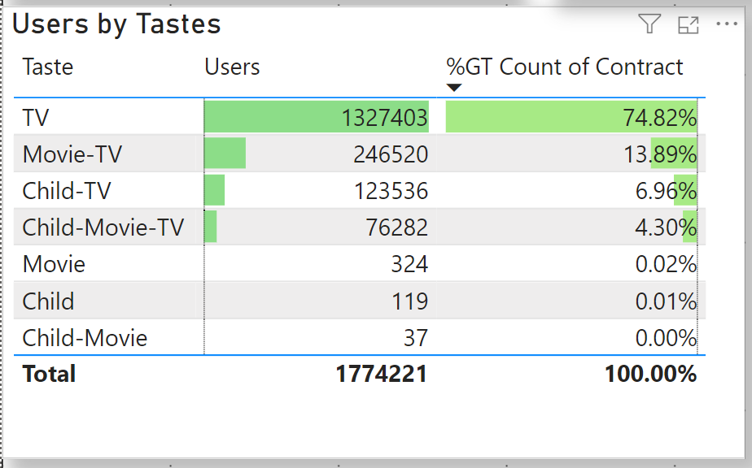
ANALYSIS
Customers who watched Movie only, Child only and Child-Movie is less than 0.03% total customers.
=> Customers either watched TV only, or main content is TV and watch Movie, and Child as an extra.

Slide 10
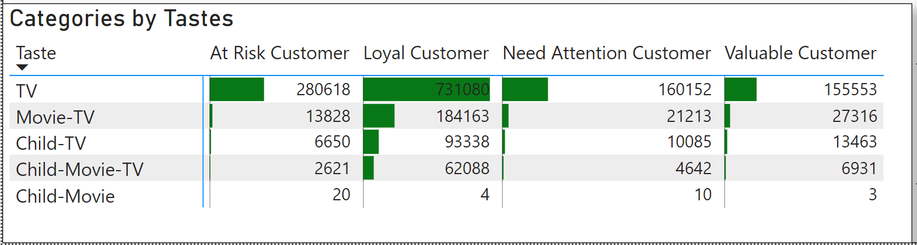
ANALYSIS
Only 37 customers watch Child-Movie but not TV
Child and Movie are NOT main products of company.
Focus on more TV content to convert customers into Loyal Customers.

Slide 11
RECOMMENDATIONS
Convert customers from into Loyal Customers to increase revenue.
More content in TV to attract more customers.
Movie and Child are NOT important contents.

